Slide 1

Data Structures and Object Oriented Programing in C++ LAB # 8 Template Functions and Classes
Lab instructor:
Syed Usman Ahmed
Email:
syed.usman2012@gmail.com

Slide 2
C++ Templates
Approaches for functions that implement identical tasks for different data types
Naïve Approach
Create unique functions with unique names for each combination of data types.
Function Overloading
Use same name for different functions, distinguished by their parameter lists
Function Template
A method that allows the compiler to generate multiple versions of a function by allowing parameterized data types.

Slide 3
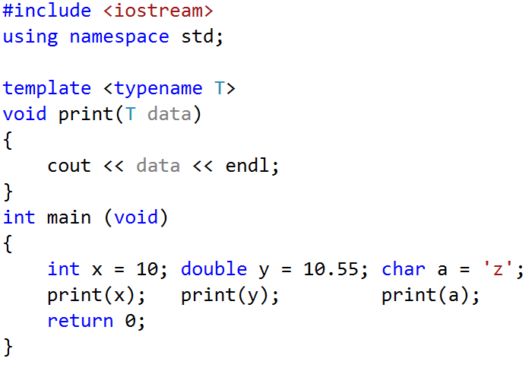
Template Function: Simple Example
Declaring a templated data type.

Slide 4
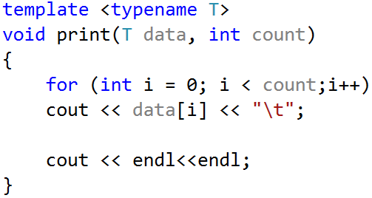
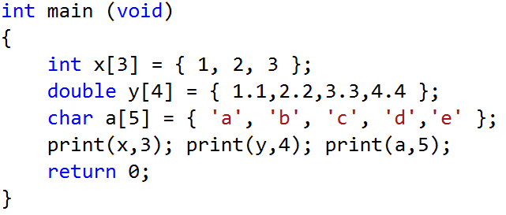
Template Function: Second Example
What happens if we change
void print(T data, int count);
to
void print(T &data, int count);
or
void print(T *data, int count);

Slide 5
What compiler does at the backend?
When the compiler detects a print function in the client program, the compiler looks for a definition of function print that best matches the function call.
In this case, the only print function with the appropriate number of parameters is the print function template.
The compiler compares the type of print function's first argument (int *) to the print function template's first parameter (const T *) and deduces that replacing the type parameter T with int would make the argument match the parameter.

Slide 6
What compiler does at the backend?
The compiler substitutes int for T throughout the template definition and compiles a print specialization that can display an array of int values.
Hence compiler creates three print specializations, one that expects an int array, one that expects a double array and one that expects a char array.
Drawback of using templates:
Multiple function-template specializations and class-template specializations are instantiated in a program (at compile time), despite the fact that the template is written only once. These copies can consume considerable memory.

Slide 7
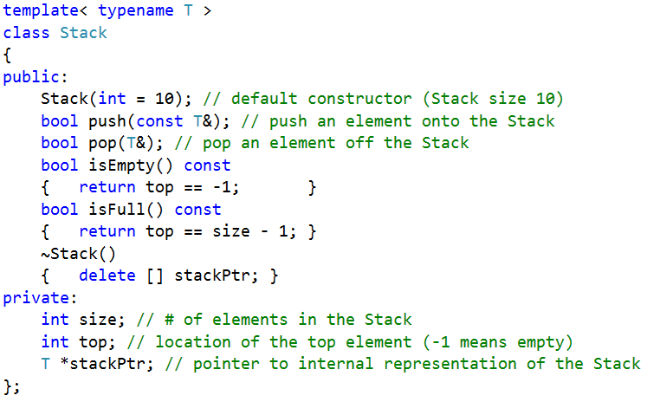
Template class: Example

Slide 8
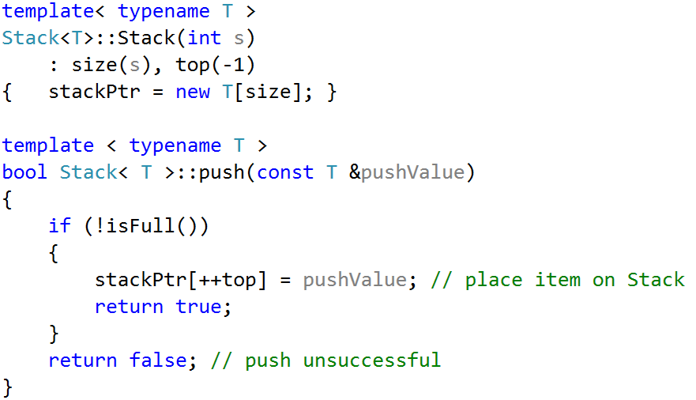
Template class: Example
NOTE:
Place this code in header file

Slide 9
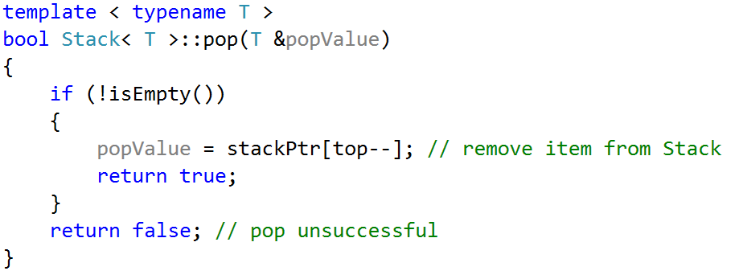
Template class: Example
Placing implementation in .cpp file results in compilation error.
For details check this link: http://stackoverflow.com/questions/456713/why-do-i-get-unresolved-external-symbol-errors-when-using-templates
NOTE:
Place this code in header file

Slide 10
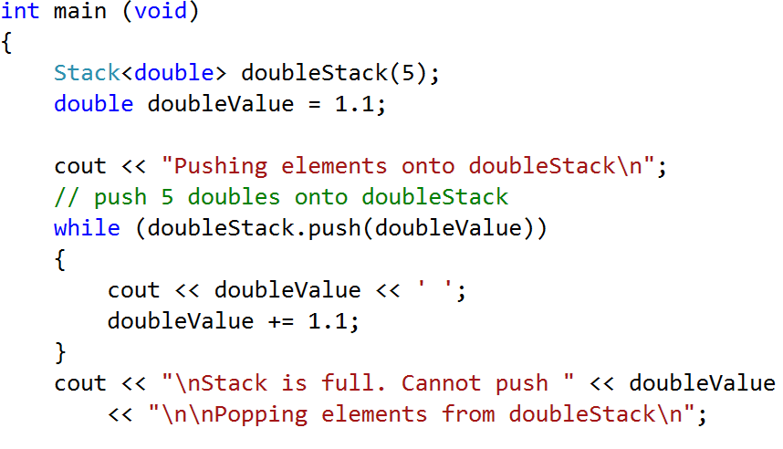
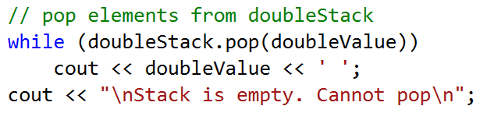
Main program

Slide 11
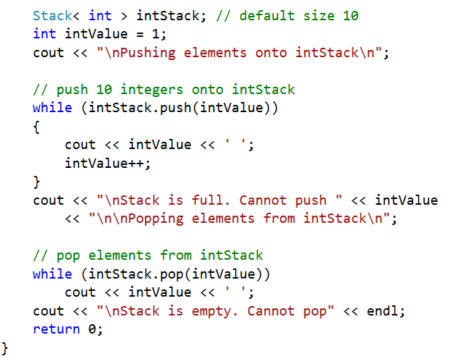
Main program

Slide 12
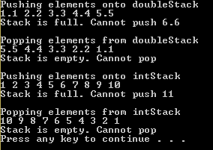
Main program: Output

Slide 13
Non-type parameters for class templates
It is also possible to use non-type template parameters or non-type parameters, which can have default arguments and are treated as consts.
Such a stack will be declared as:

Slide 14
Default types for class templates
Type parameter can specify a default type.
Such a stack will be declared as:

